Slide 1


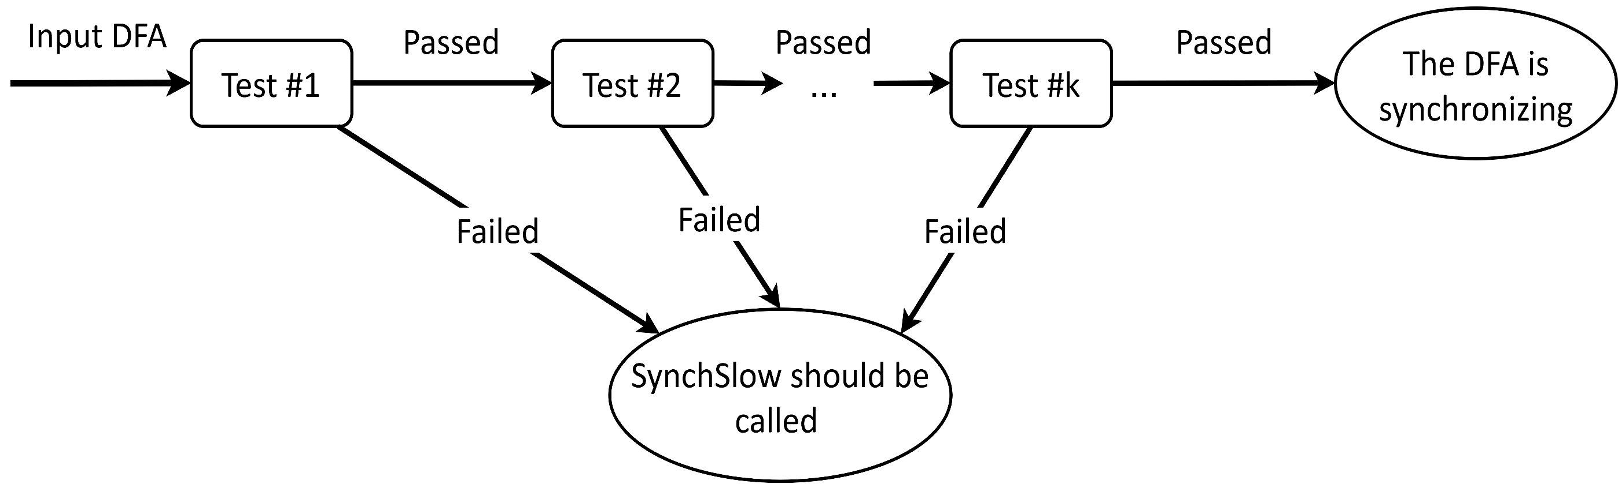
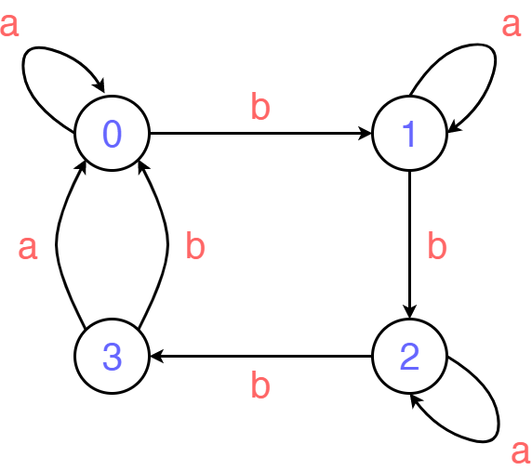
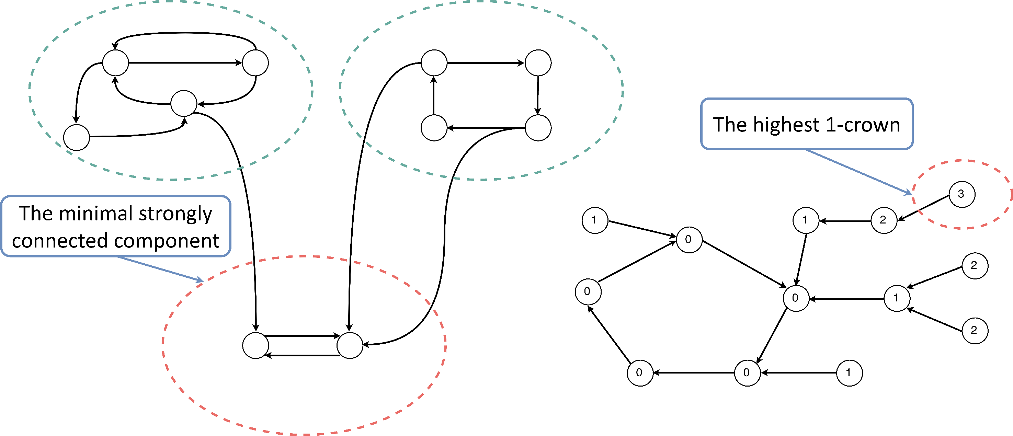
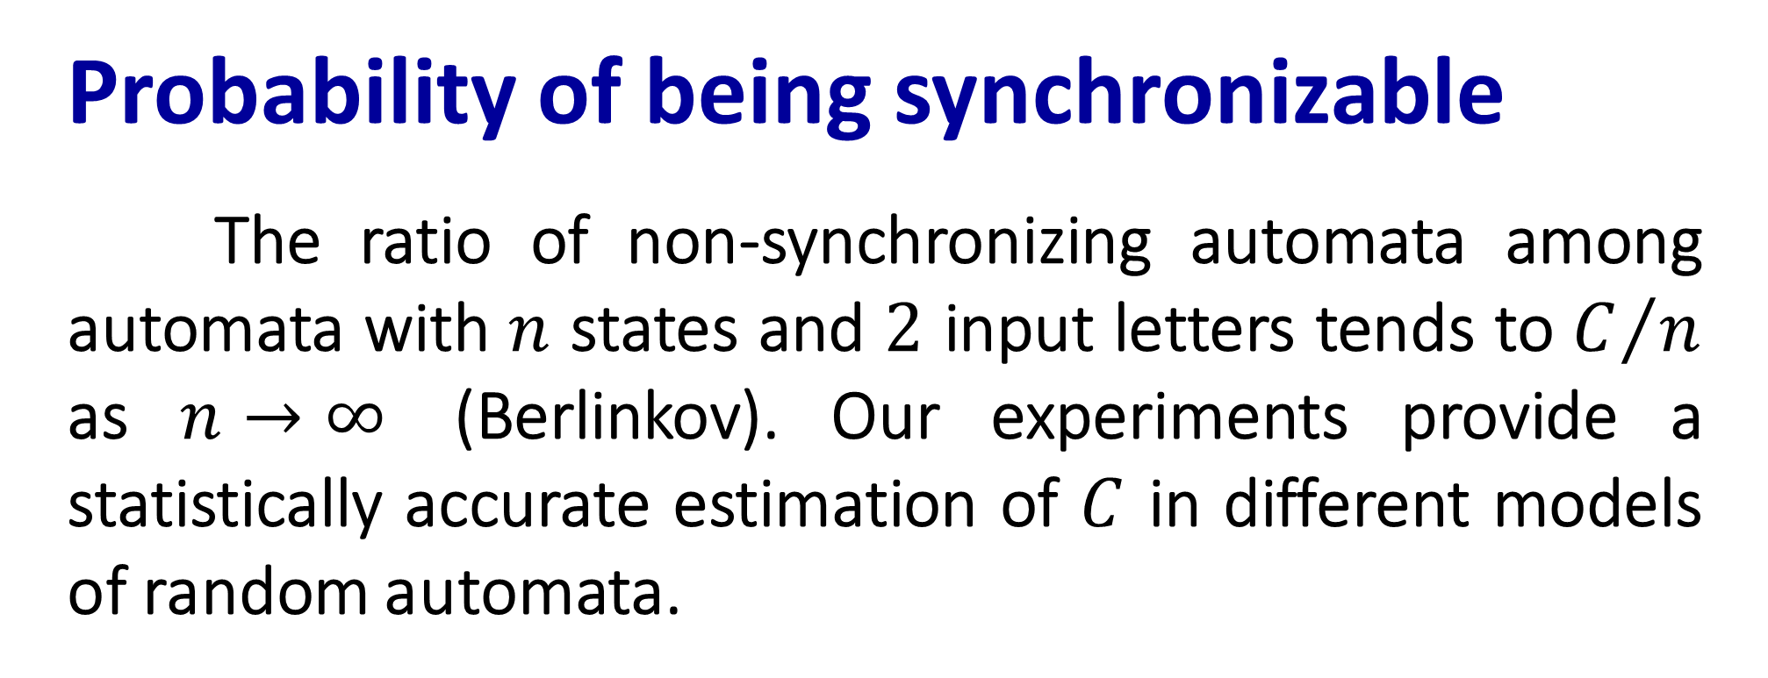
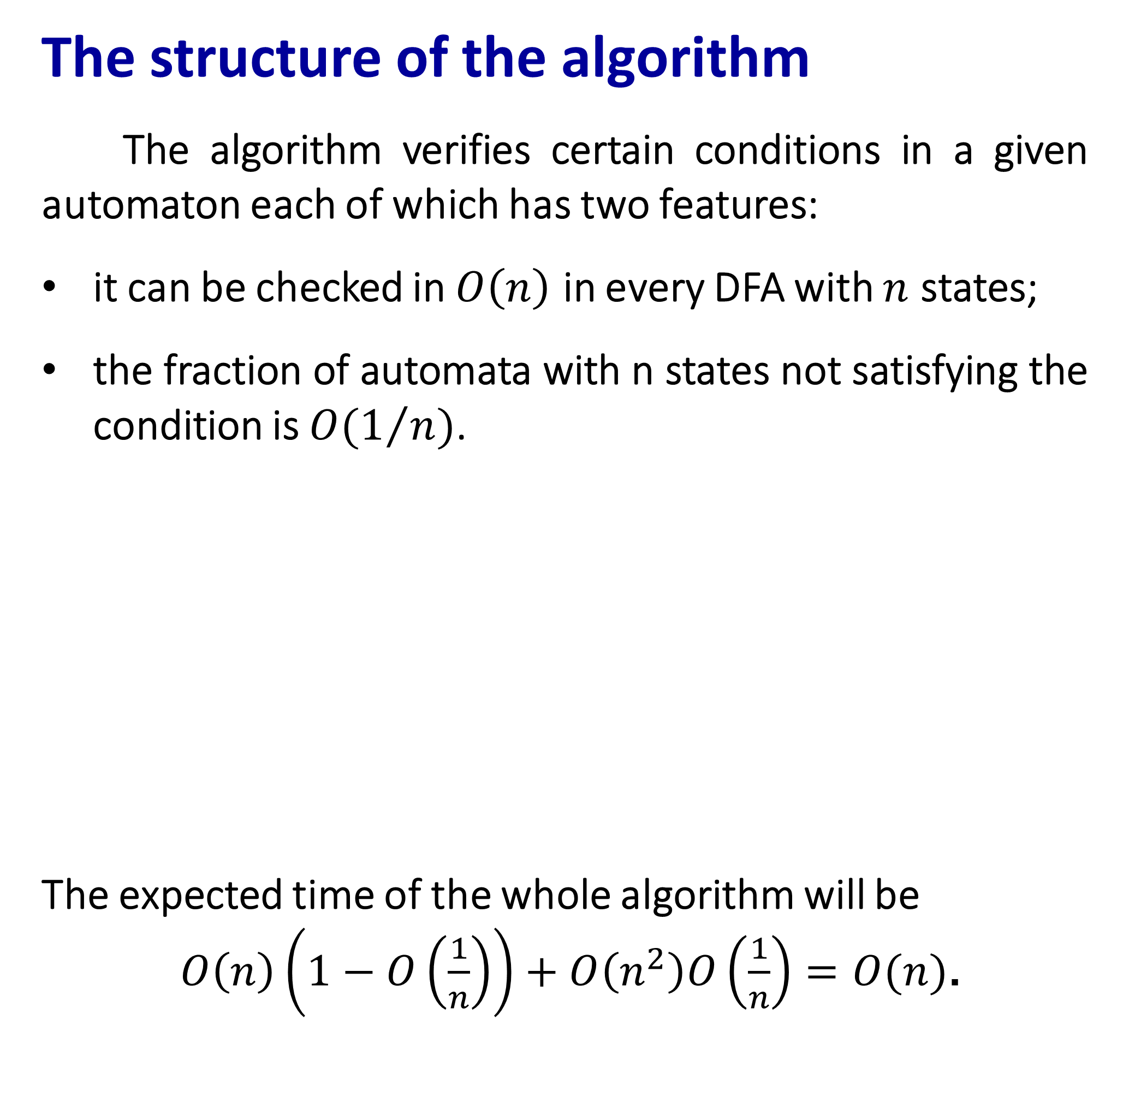
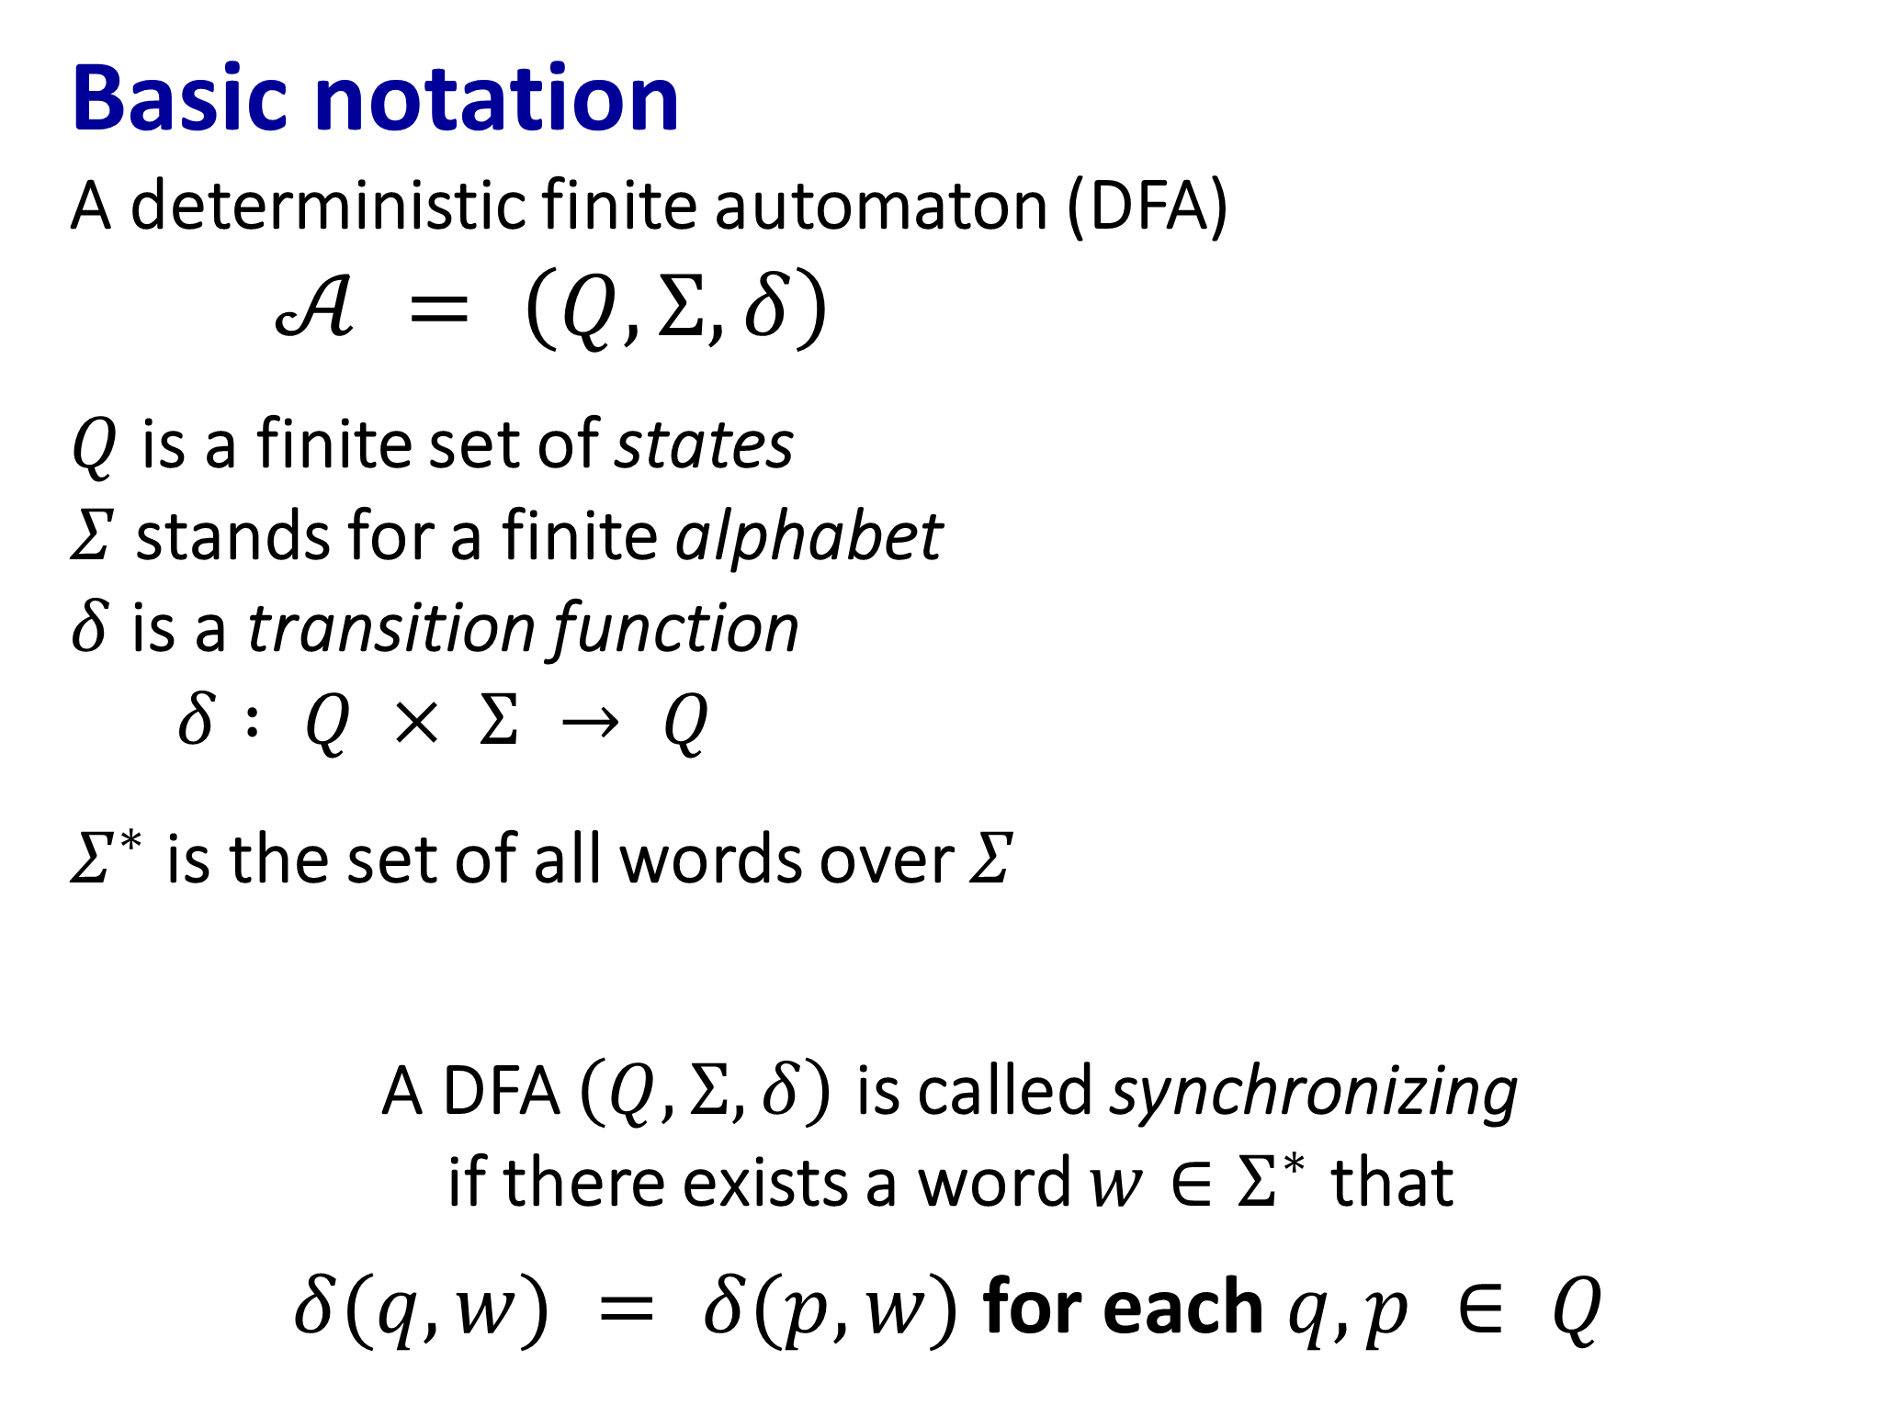
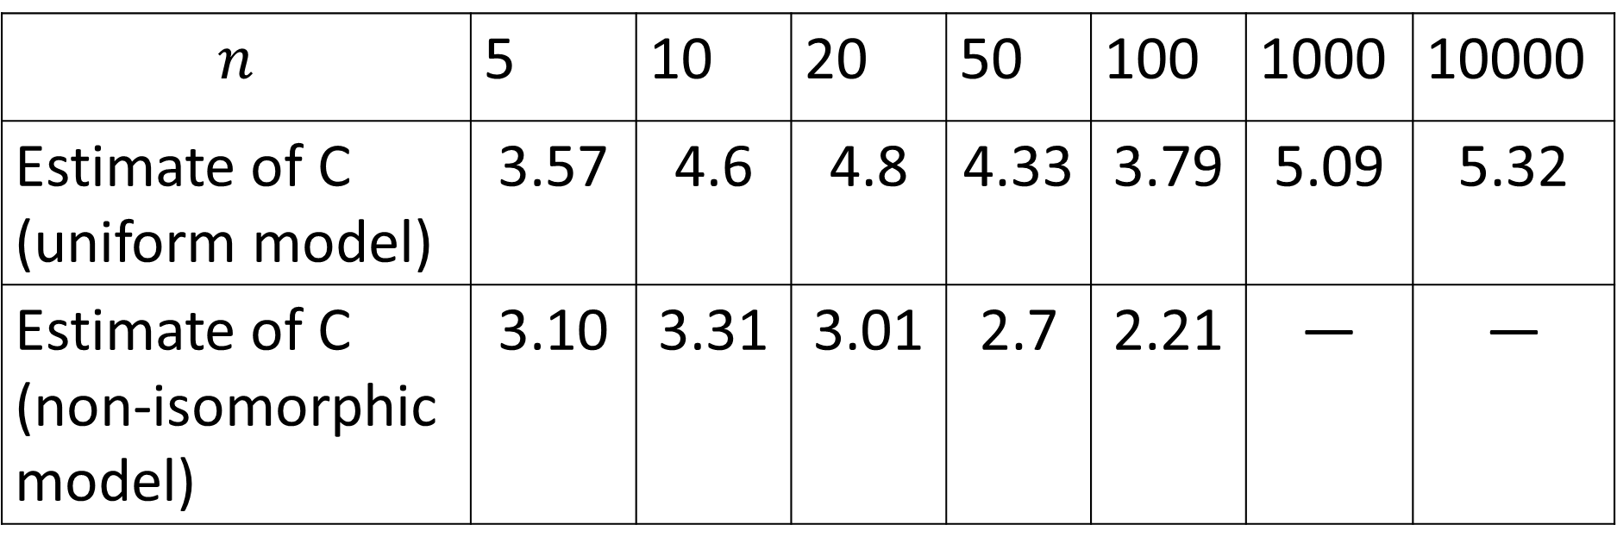
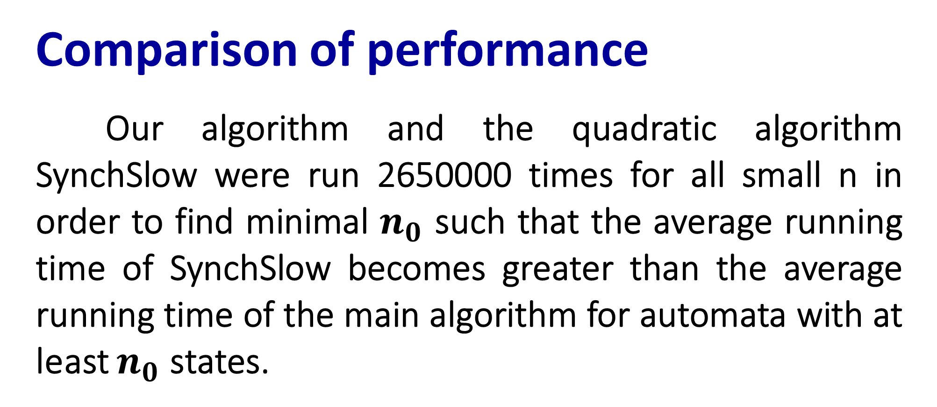
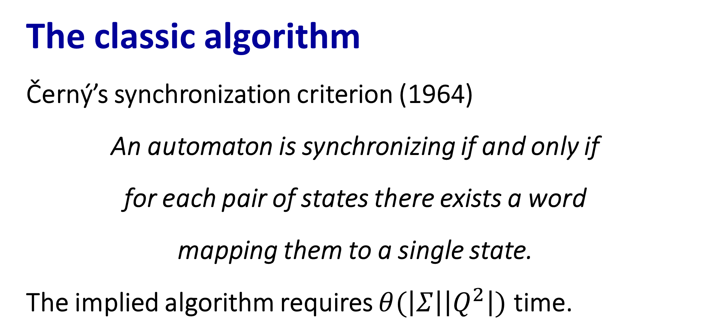
Testing an automaton for synchronization in linear expected time
Pavel Ageev, Yekaterinburg
Results
The first practically effective implementation of the algorithm for testing an automaton for synchronization in linear expected time
Statistically accurate evaluation of the fraction of synchronizing automata amongst all automata with n states
The structure of the algorithm
The algorithm verifies certain conditions in a given automaton each of which has two features:
it can be checked in $O\left(n\right)$ in every DFA with $n$ states;
the fraction of automata with n states not satisfying the condition is $O(1/n)$.
The expected time of the whole algorithm will be
$O\left(n\right)\left(1−O\left(\frac{1}{n}\right)\right)+O\left(n^{2}\right)O\left(\frac{1}{n}\right)=O(n)$.
Probability of being synchronizable
The ratio of non-synchronizing automata among automata with $n$ states and $2$ input letters tends to $C/n$ as $n→∞$ (Berlinkov). Our experiments provide a statistically accurate estimation of $C$ in different models of random automata.
$$n$$ | 5 | 10 | 20 | 50 | 100 | 1000 | 10000
Estimate of C (uniform model) | $$\text{3.57}$$ | $$\text{4.6}$$ | $$\text{4.8}$$ | $$\text{4.33}$$ | $$\text{3.79}$$ | $$\text{5.09}$$ | $$\text{5.32}$$
Estimate of C (non-isomorphic model) | $$\text{3.10}$$ | $$\text{3.31}$$ | $$\text{3.01}$$ | $$\text{2.7}$$ | $$\text{2.21}$$ | — | —
Basic notation
A deterministic finite automaton (DFA)
$𝒜 = \left(Q, Σ, δ\right)$
$Q$ is a finite set of states
$Σ$ stands for a finite alphabet
$δ$ is a transition function
$δ : Q × Σ → Q$
$Σ^{∗}$ is the set of all words over $Σ$
A DFA $\left(Q, Σ, δ\right)$ is called synchronizing
if there exists a word $w∈Σ^{∗}$ that
$δ(q, w) = δ(p, w)$ for each $q, p ∈ Q$
Comparison of performance
Our algorithm and the quadratic algorithm SynchSlow were run 2650000 times for all small n in order to find minimal $n_{0}$ such that the average running time of SynchSlow becomes greater than the average running time of the main algorithm for automata with at least $n_{0}$ states.
Our improvements
All the modifications consisted in
omitting some of the conditions utilized in the original paper by Berlinkov
checking a different condition instead.
Applications
Part handling problems
Biocomputing
Coding theory
An example of the improvement
Many cute problems (partly open)
Road coloring theorem
Černý conjecture
Acknowledgments
The author is grateful to his scientific advisor Professor Mikhail Volkov for helping with the article, to Mikhail Berlinkov for the explanation of his algorithm and to Mikhail Samoilenko for useful discussions.
The classic algorithm
Černý’s synchronization criterion (1964)
An automaton is synchronizing if and only if
for each pair of states there exists a word
mapping them to a single state.
The implied algorithm requires $θ(\left|Σ\right|\left|Q^{2}\right|)$ time.
The point is that, in all cases, it was the “new” condition that was implicitly used in the original algorithm while the role of the “old” condition was to ensure that the “new” one holds with high probability. Therefore checking the “new” condition instead of the “old” one straightens the algorithm and decreases the probability of invoking the slow algorithm.
References
Ageev, P.: Implementation of the algorithm for testing an automaton for synchronization in linear expected time, http://arxiv.org/abs/1710.00258 CoRR abs/1710.00258
Berlinkov, M.V.: On the probability of being synchronizable, pp. 73–84. LNCS, volume 9602 (2016). http://dx.doi.org/10.1007/978-3-319-29221-2_7

